Slide 1
Golden Eagle Regional Park 2018 Annual Report
By Tony Pehle, Recreation Manager

Slide 2
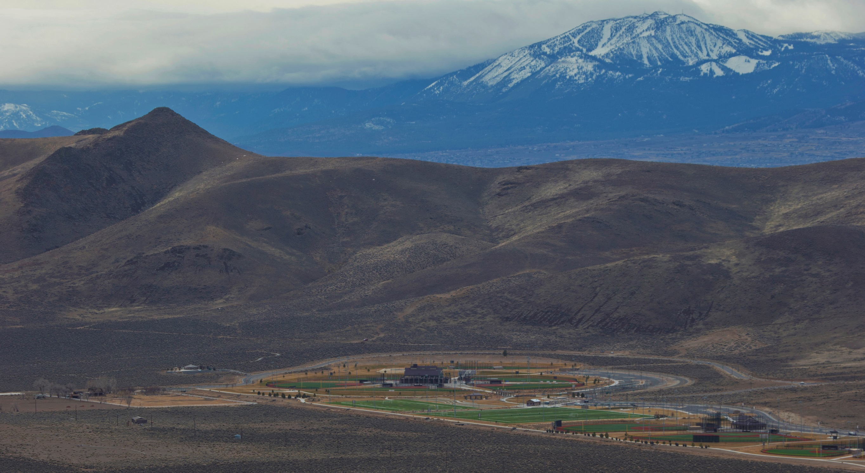

Slide 3
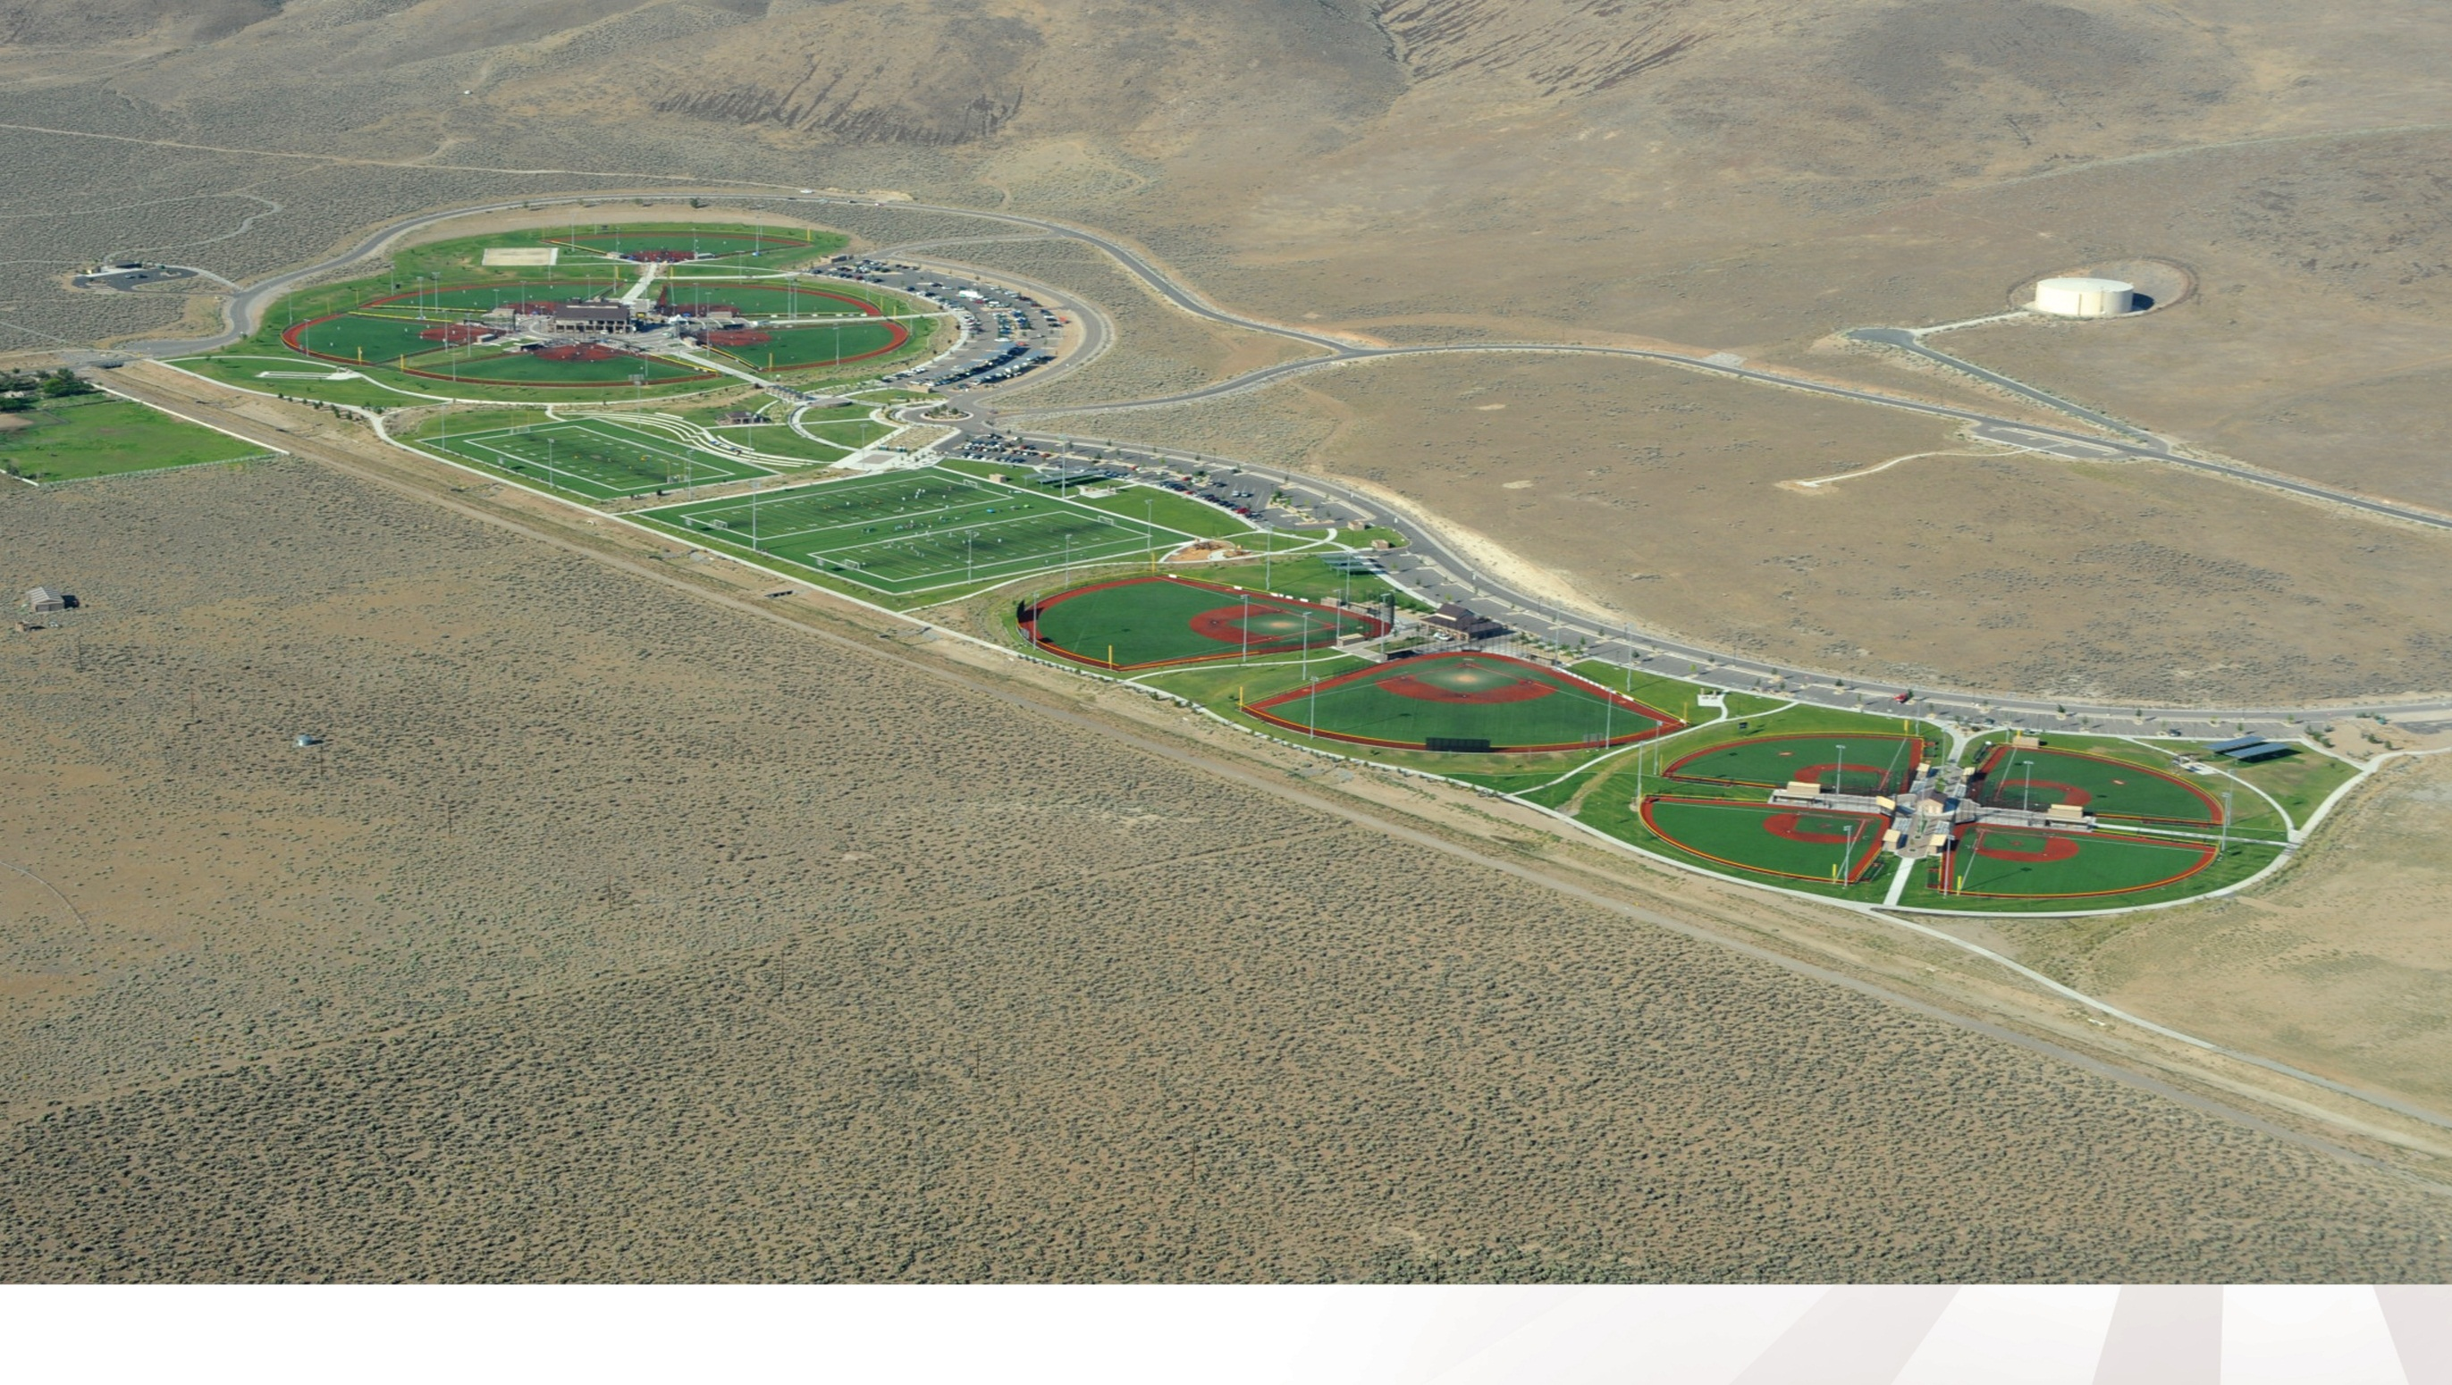

Slide 4
Golden Eagle Regional Park
Generated an estimated $24.4 Million in Economic Impact from Tournaments and Events;
Attracted over 1 million participants and spectators for league and tournament games;
Hosted 53 tournaments & events in 2018.

Slide 5
Golden Eagle Regional Park
Since opening to the public in the Spring of 2008, the Sports Complex has been filled with players and spectators of all ages and skill levels.
The softball fields are booked solid with tournaments on weekends from mid-January through November, with teams from Alaska, Hawaii, and Florida.

Slide 6
Golden Eagle Regional Park
Brought 1,175 visiting teams to Sparks equating to 43,000+ room nights;
10,000+ games played on the 15 synthetic fields, including 3,500 city league softball games and 4,600 tournament games;
Hosted 11 tournaments with 50-200 teams participating in each tournament.

Slide 7
Golden Eagle Regional Park
In 2018 we continued to fill our fields and had an incredible Economic Impact on Northern Nevada.
Live streamed games on the internet, social media, our reputation for a great complex and weather has made Golden Eagle Regional park one of the premier complexes in the country.

Slide 8
Golden Eagle Regional Park

Slide 9
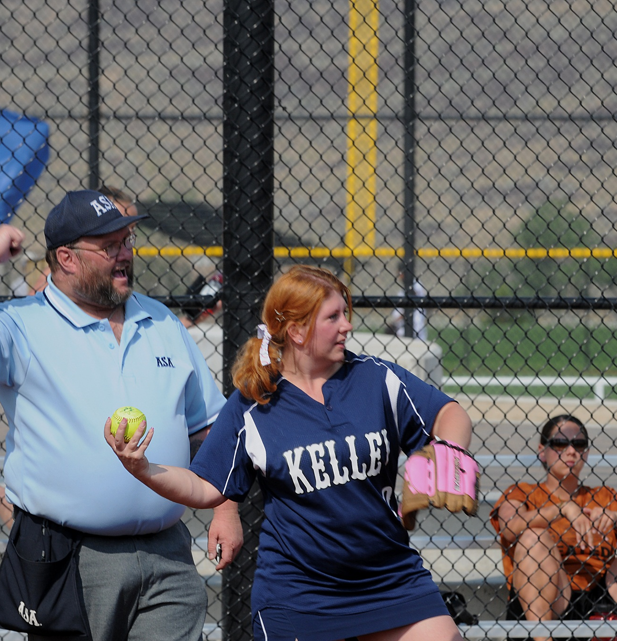
Golden Eagle Regional Park
Generated $179,207 revenue from 950 field rentals in FY19.
The facility is home to over 500 local softball & kickball teams participating 11 months each year.
The facility hosts numerous regional and national events for organizations like:
USA Softball; Senior Softball USA; Athletx & Triple Crown Sports

Slide 10
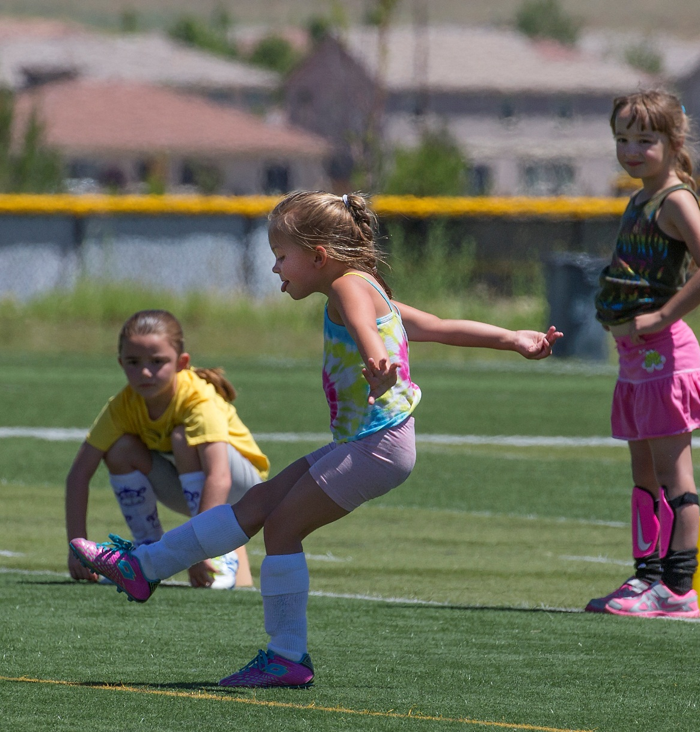
Golden Eagle Regional Park
Revenues are generated from:
Field Rentals;
Restaurant Lease;
Tournament Rentals;
Player Assessment Fees;
Lighting Fees; and
Registration Fees

Slide 11
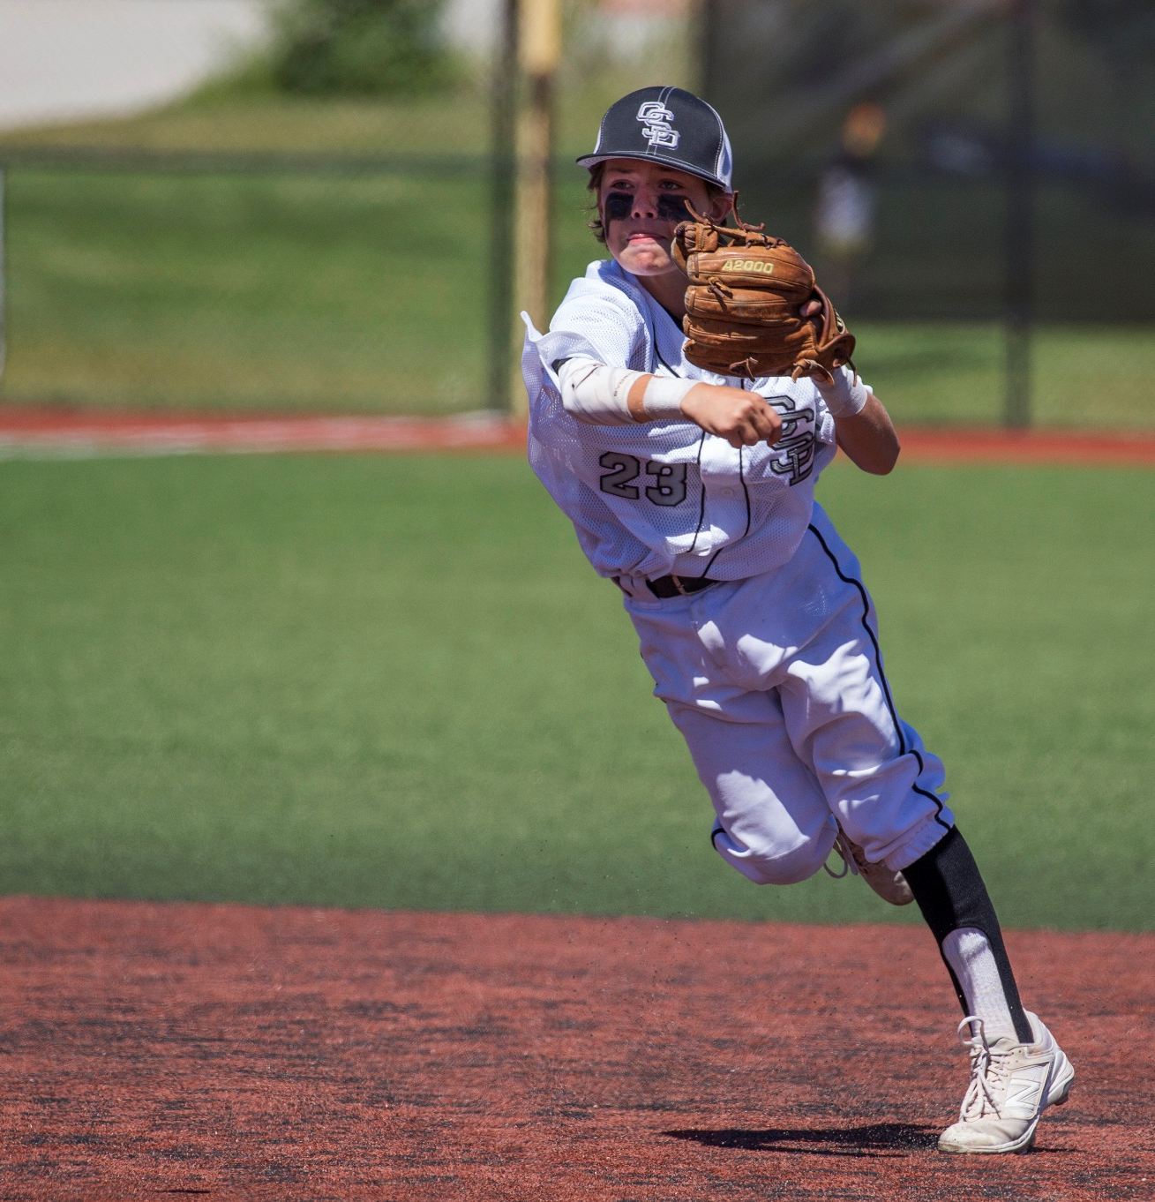
Golden Eagle Regional Park
Lastly, the facility continues to host a variety of youth sports leagues for games and practices that occur 7 days a week, 9 months each year.
Sparks Babe Ruth
Sparks Centennial Little League
Sparks Centennial Softball
Sparks National Little League
Pop Warner Football
Sierra Youth Football League
AYSO Soccer
Great Basin Youth Soccer League (GBYSL)
Northern Nevada Soccer League

Slide 12
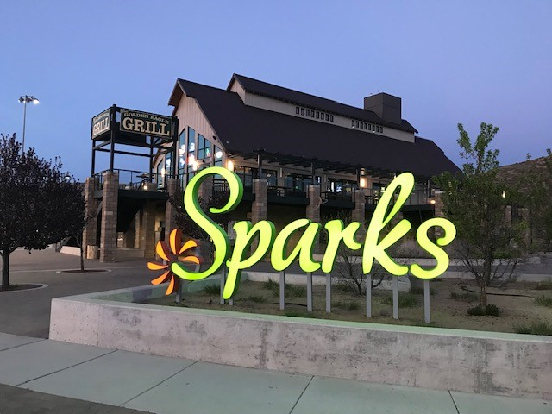

Slide 13
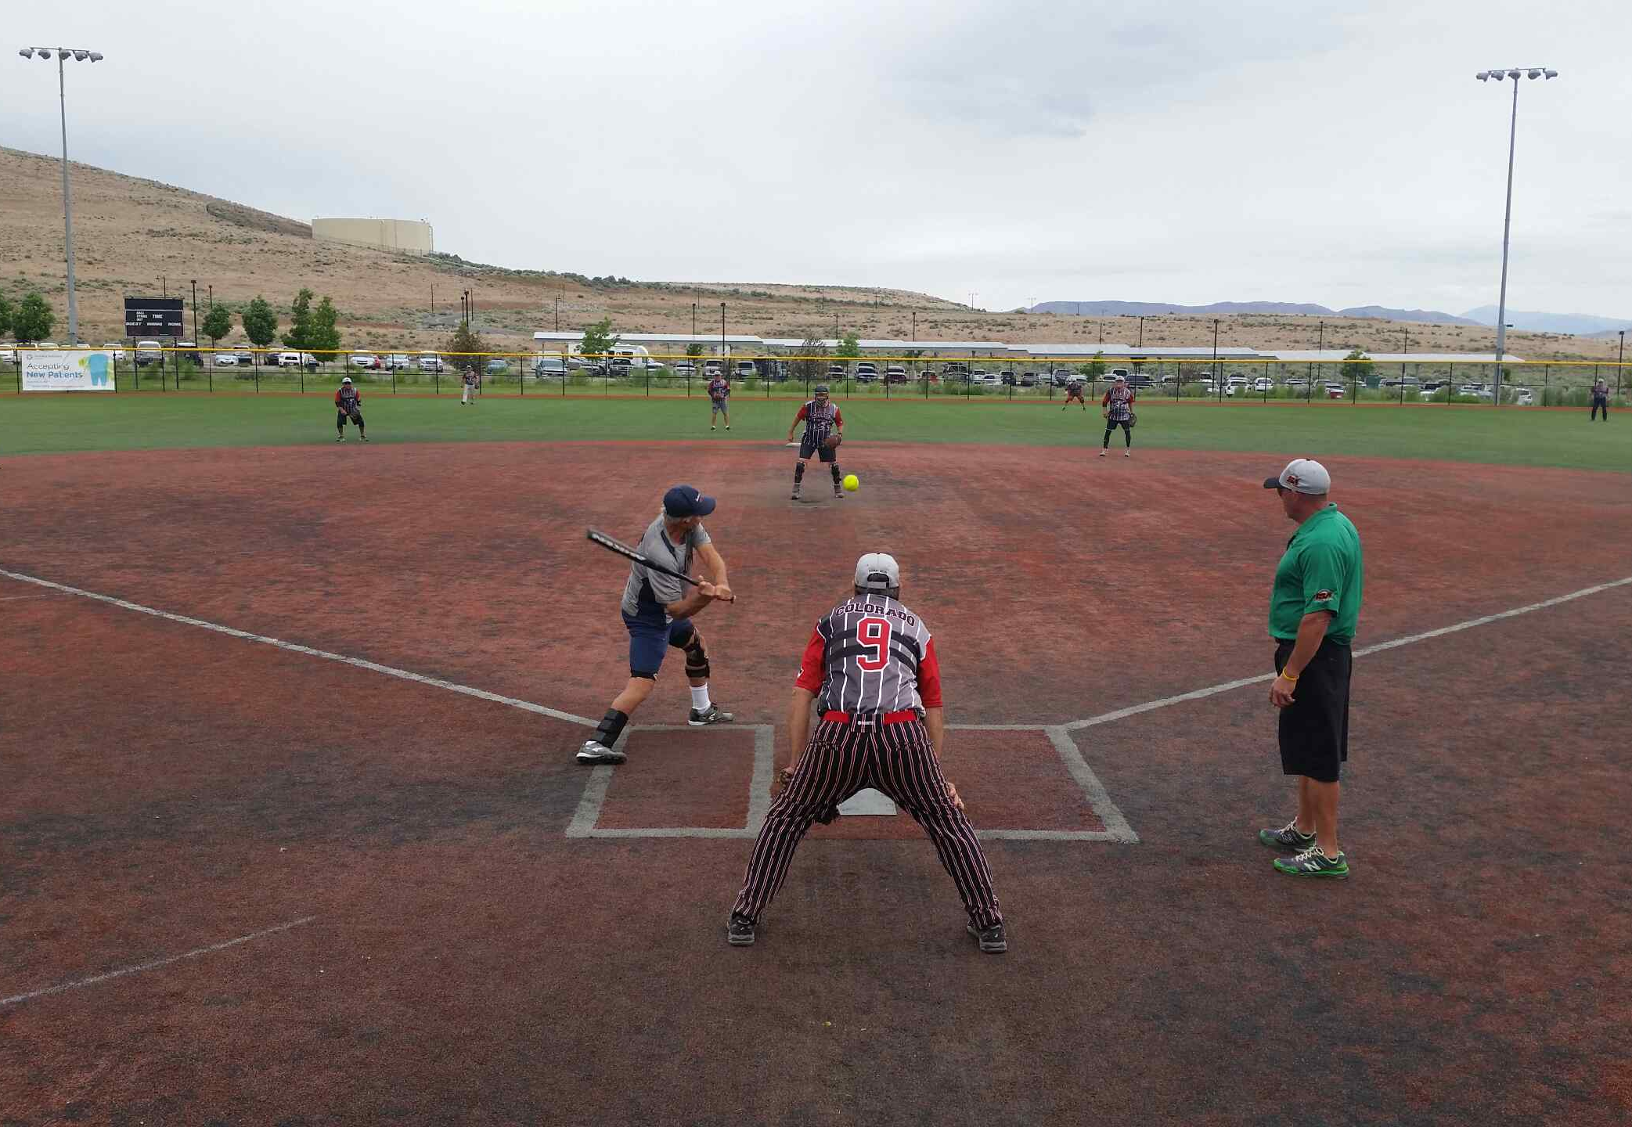
Thank you for your ongoing support.
Questions?

